Slide 1

Slide 1
Sales Forecast For Sporting Goods
Bengi Koseoglu, Na Gong, Qian Xia, Sanjita Suresh

Slide 2
Slide 9
AGENDA
Pre-processing
Predictive Analytics
Data Cleaning
Feature Engineering
Combining
Clustering
Predictive Modeling
Ensemble Learning
Problem Statement
Exploratory Data Analysis
Feature Selection
Items
Price
Train
2

Slide 3

Slide 2
PROBLEM STATEMENT
E-commerce sporting goods company
Goal: Predict the sold out date of the products for February
Stock at the begining of the month
Sales unit of each day
Sales data between october 2017 and January 2018 that covers 12824 unique products
Solution : Predict the daily sales of each products and substract it from the stock.
Tools: Python, R, RapidMiner
Product | Day | Pred | Remaing stock
Id1 | 01.02.2019 | 0 | 4
Id1 | 02.02.2019 | 1 | 3
id1 | 02.03.2019 | 3 | 0
3

Slide 4
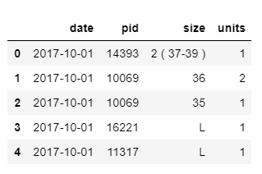
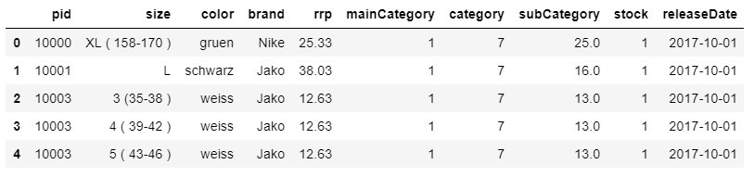
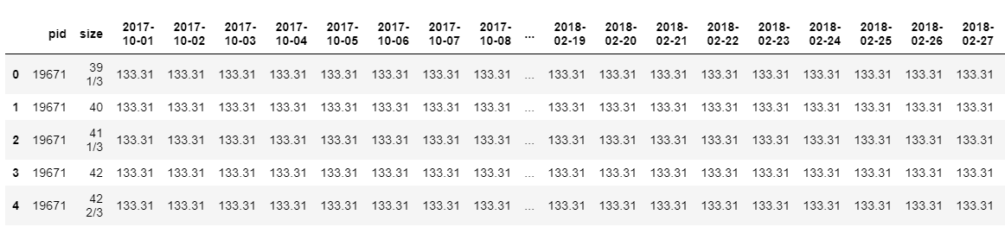
Slide 2
EXPLORATORY DATA ANALYSIS
We have three datasets
Items: serves as master data
Train: daily sales of products
Price: historical pricing information between october and february
Items
Train
Price
4

Slide 5
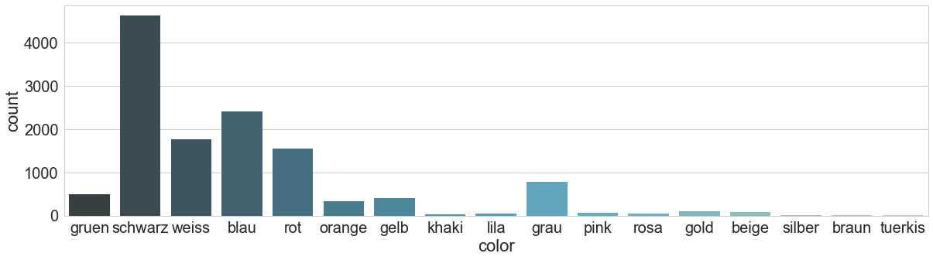
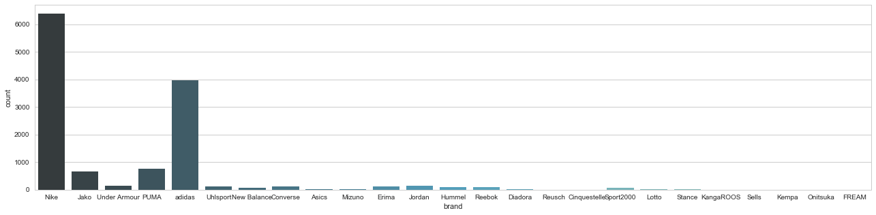
Slide 2
EXPLORATORY DATA ANALYSIS
5

Slide 6
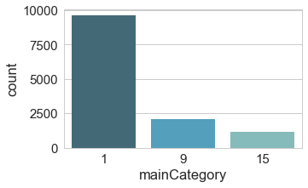
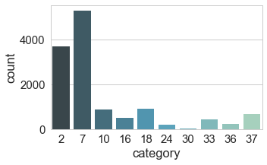
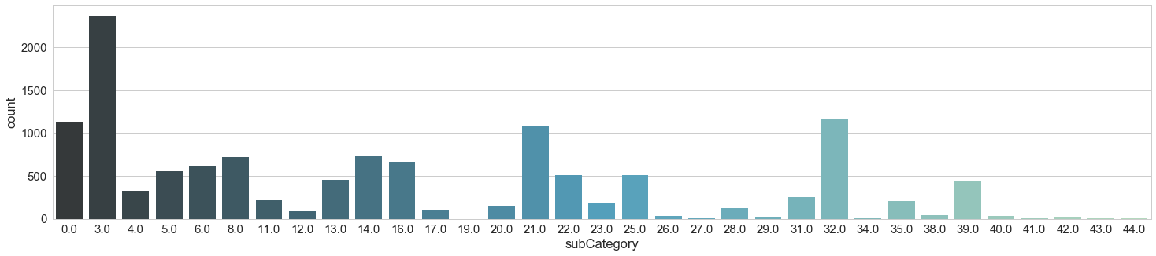
Slide 2
EXPLORATORY DATA ANALYSIS
6

Slide 7
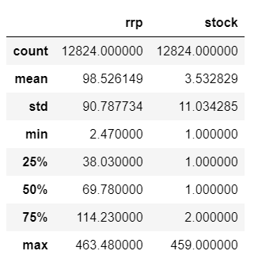
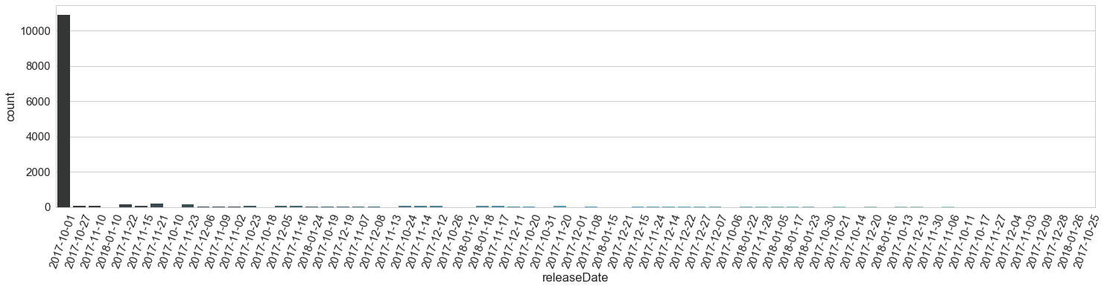
Slide 2
EXPLORATORY DATA ANALYSIS
7

Slide 8
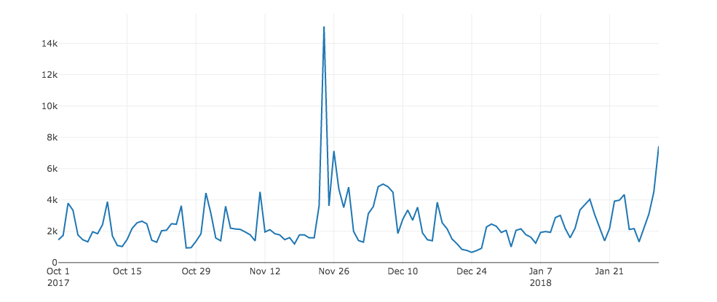
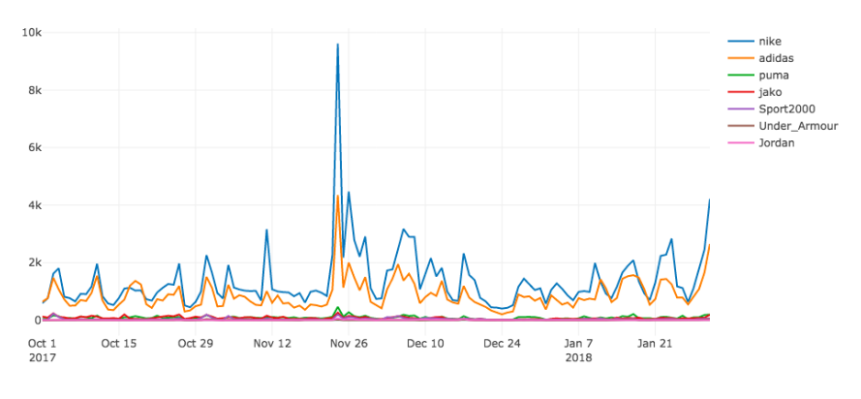
Slide 2
EXPLORATORY DATA ANALYSIS
Black Friday
Shopping Day Germany
Black Friday
Shopping Day Germany
8

Slide 9
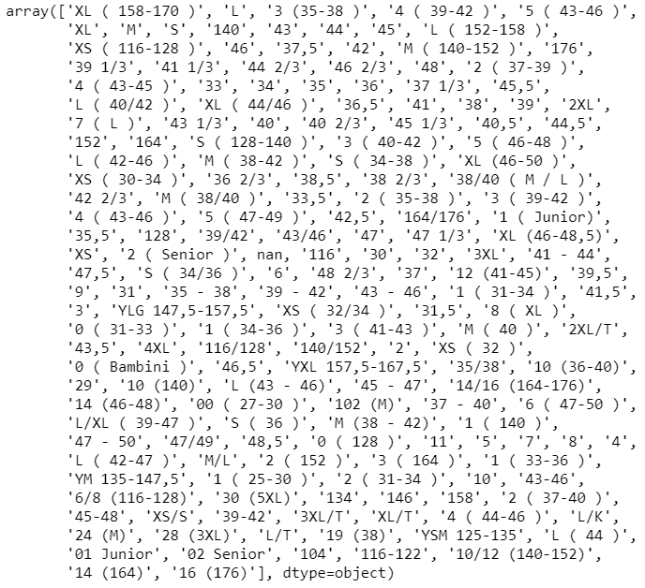
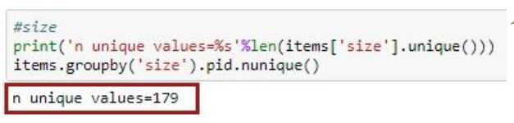
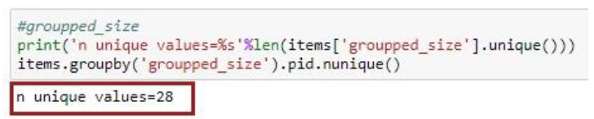
Slide 2
PRE-PROCESSING (Data Cleaning)
A unique column id is created
Missing variables are handled
Price attributes in price dataset: mean of the product‘s average price
Subcategory attribute in items dataset: created another category
For size attribute in items dataset: filled with most frequent size of each brand
Size information translated into a unified format
9

Slide 10
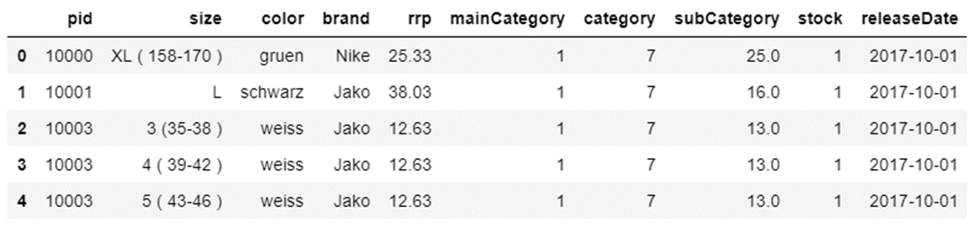
Slide 2
PRE-PROCESSING(Feature Engineering)
Price_daily_change : Price change of product compared to previous day
New_product: Binary variable, based on release day
Day: Day of the month
Month: Month as categorical variable
Weekday: Monday, Tuesday etc. as numerical variable
Holiday: Binary variable (Christmas, school holiday)
Avg_temp / Med_temp : average and median weather information of Germany
10

Slide 11
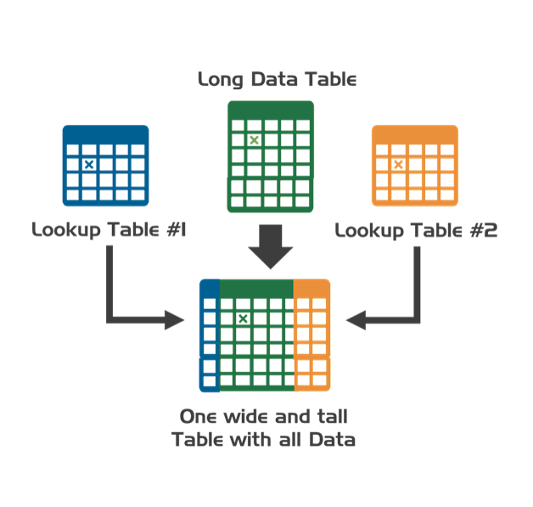
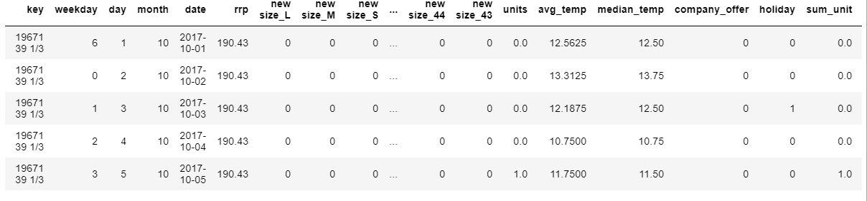
Slide 2
PRE-PROCESSING (Combining)
Categorical variables are convered to dummy variables
Black Friday is removed from the dataset
All datasets are combined -> 1.564.528 rows and 210 columns
11
Notes:
18 new features with 200 dummy variables are created.

Slide 12
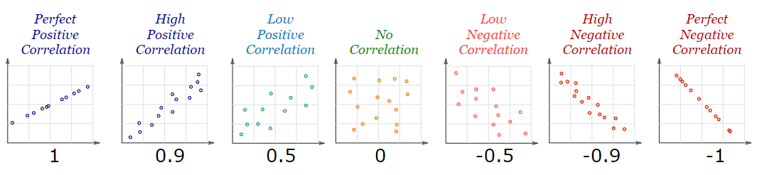
Slide 2
FEATURE SELECTION
Sales
Sales
Weather
Weather
Sales
Weather
12
Notes:
20 top variables selected from the each feature selection algorithm. The final results are tabulated based on the number of times the individual variable

Slide 13


Slide 2
FEATURE SELECTION
New Product
New size_m
New size_l
Brand: nike
Brand: adidas
Brand: sport2000
Color: blau
Color: grau
Color: schwarz
Color: weiss
Temp: avg
Temp: med
Day: 5
Day: 6
……..
Weekday_1
Weekday_2
Weekday_3
Weekday_4
Weekday_5
Weekday_6
Weekday_7
Price_daily_change
Holiday
……..
34 variables are selected
13
Notes:
20 top variables selected from the each feature selection algorithm. The final results are tabulated based on the number of times the individual variable

Slide 14
Slide 9
AGENDA
Pre-processing
Predictive Analytics
Data Cleaning
Feature Engineering
Combining
Clustering
Predictive Modeling
Ensemble Learning
Problem Statement
Exploratory Data Analysis
Feature Selection
Items
Price
Train
14

Slide 15
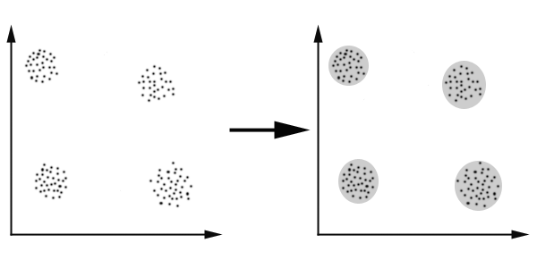
Slide 2
PREDICTIVE ANALYTICS
Clustering
+
Predictive Modeling
Predictive Modeling on the whole data
15
Notes:
Instead of predicting the sales for whole products or for individual products, products can be grouped according to their similarities and models can be built on top clusters
During time series clustering, we only used sales data between 2017 and 2019.

Slide 16
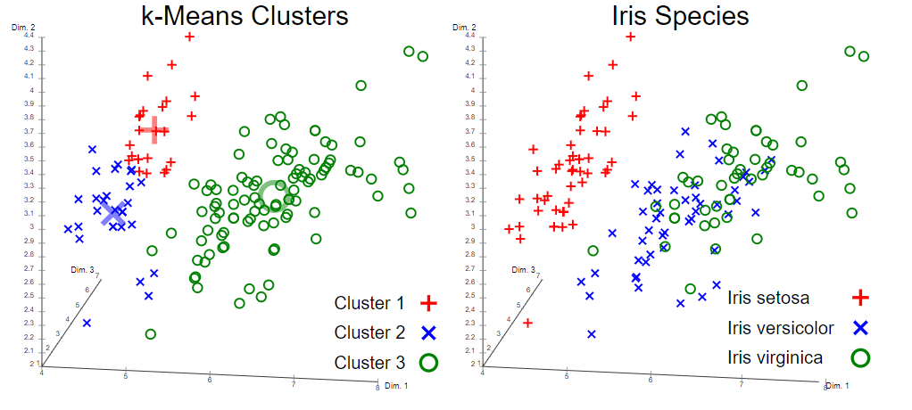

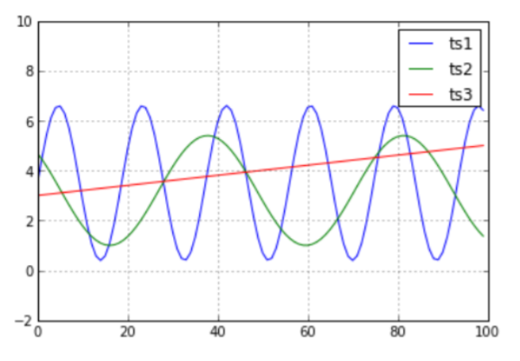

Slide 2
PREDICTIVE ANALYTICS (Clustering)
d(ts1,ts2)=26.9
d(ts1,ts3)=23.2
Brand
Clustering
Category Clustering
K- Means
Clustering
Dynamic Time Warping
Clustering
Nike
Adidas
PUMA
Jako
Other brands
mainCategory_1
mainCategory_9
mainCategory_15
- Input: items (!no sale info)
- Result: items that are similar to each other
Input: Sale trend for each product
Result: items that have similar sales units and trend across time
4
16
Notes:
Instead of predicting the sales for whole products or for individual products, products can be grouped according to their similarities and models can be built on top clusters
During time series clustering, we only used sales data between 2017 and 2019.

Slide 17
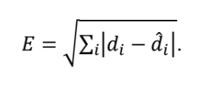
Slide 2
PREDICTIVE ANALYTICS (Clustering)
Actual Day
Prediction Day
Actual Sold out date = 24th of June
Predicted Sold out date = 16 th of June
Difference= 8 days
Clustering | Performance
K-means | 280
Main Category | 276.6
Brand | 276.1
Time Series | 261
* Gboost regression without parameter tunning
17
Notes:
Instead of predicting the sales for whole products or for individual products, products can be grouped according to their similarities and models can be built on top clusters
During time series clustering, we only used sales data between 2017 and 2019.

Slide 18
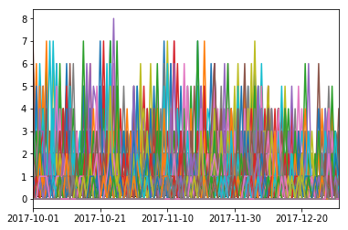
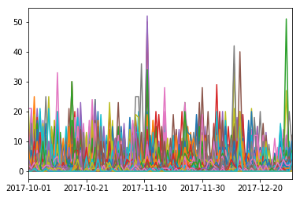
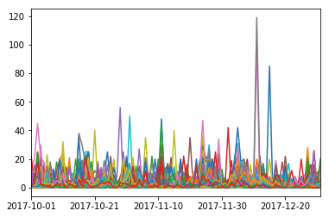
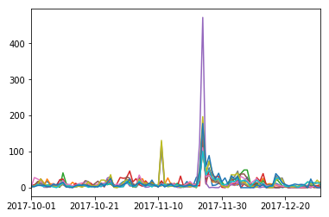
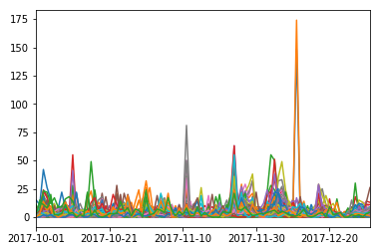
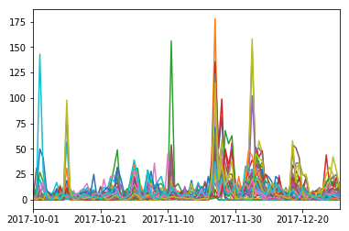
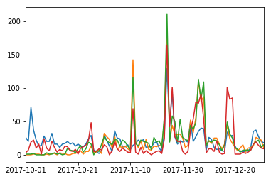
Slide 2
PREDICTIVE ANALYTICS (Clustering)
Cluster 1
Cluster 2
Cluster 3
Cluster 4
Cluster 5
Cluster 6
Cluster 7
18
Notes:
During time series clustering, we only used sales data between 2017 and 2019.
This clustering methodology includes using Dynamic Time Warping(DTW), which is a similarity measure that allows comparisons of two time-series sequences, coupled with hierarchical clustering [1]. DTW was calculated using R, and the resulted distance matrix passed to the hiearchical clustering

Slide 19

Slide 2
PREDICTIVE ANALYTICS (Modeling)
01
ARIMA Model
Pure time series model
Sales forecasting
02
Windowing Approach
Treating time series forecast a regression problem
03
Regression Model
Predict daily unit sales for each day by using regression
04
Combined Model
Train different models for each cluster
19
Notes:
In the time series, it's assumed that preceding values will have an affect on the current value. One way to account for this is to
Apply models that are capable of capturing different temporal structures and seasonality such Autoregressive Integrated Moving Average Model(ARIMA).
Treat time series forecast as a regression problem while taking preceding sales into account such as windowing.
Predict daily unit sales for each day by using regression and machine learning methodologies.

Slide 20
Slide 2
PREDICTIVE ANALYTICS (Modeling)
Train
Test
19
Notes:
In the time series, it's assumed that preceding values will have an affect on the current value. One way to account for this is to
Apply models that are capable of capturing different temporal structures and seasonality such Autoregressive Integrated Moving Average Model(ARIMA).
Treat time series forecast as a regression problem while taking preceding sales into account such as windowing.
Predict daily unit sales for each day by using regression and machine learning methodologies.

Slide 21
Slide 2
PREDICTIVE ANALYTICS (ARIMA)
Arima All
Direct Result
Model | Performance
ARIMA All | 280
ARIMA Time Clustering | 276.6
C1: Arima
C2:Arima
C4:Arima
C3:Arima
Average
C7.Arima
*Arima= $\frac{\begin{aligned}\text{C}\text{1: }\text{Arima}\text{ + }\text{C}\text{2: }\text{Arima}\text{ + }\text{C}\text{3: }\text{Arima}\text{ + }\text{C}\text{4: }\text{Arima}\text{ +} \\ \text{C}\text{5: }\text{Arima}\text{ + }\text{C}\text{6: }\text{Arima}\text{ + }\text{C}\text{7: }\text{Arima}\end{aligned}}{7}$
C6:Arima
C5:Arima
20
Notes:
In the time series, it's assumed that preceding values will have an affect on the current value. One way to account for this is to
Apply models that are capable of capturing different temporal structures and seasonality such Autoregressive Integrated Moving Average Model(ARIMA).
Treat time series forecast as a regression problem while taking preceding sales into account such as windowing.
Predict daily unit sales for each day by using regression and machine learning methodologies.

Slide 22
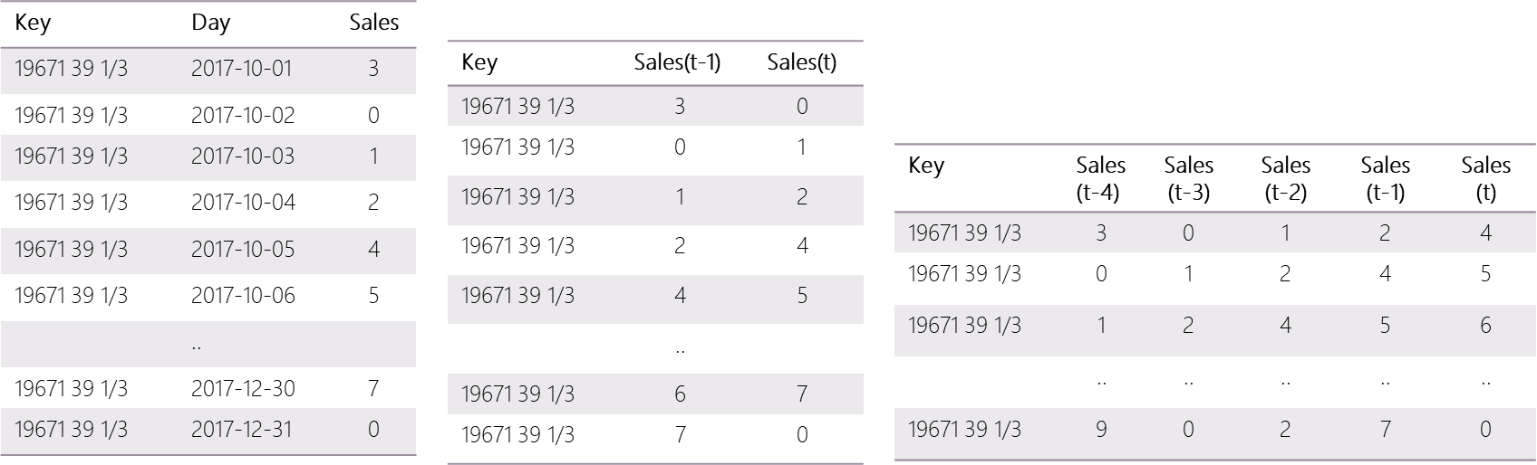
Slide 2
PREDICTIVE ANALYTICS (Windowing)
Lag 1
Lag 4
21
Notes:
In the time series, it's assumed that preceding values will have an affect on the current value. One way to account for this is to
Apply models that are capable of capturing different temporal structures and seasonality such Autoregressive Integrated Moving Average Model(ARIMA).
Treat time series forecast as a regression problem while taking preceding sales into account such as windowing.
Predict daily unit sales for each day by using regression and machine learning methodologies.

Slide 23
Slide 2
PREDICTIVE ANALYTICS (Windowing)
Average
C1: W1 (1) Reg
C1: W2 (20) Ann
C1: W3 (20) Reg
C1: W4 (30) Reg
C2: W1 (1) Reg
C2: W2 (20) Ann
C2: W3 (20) Reg
C2: W4 (30) Reg
C3: W1 (1) Reg
C3: W2 (20) Ann
C3: W3 (20) Reg
C3: W4 (30) Reg
C4: W1 (1) Reg
C4: W2 (20) Ann
C4: W3 (20) Reg
C4: W4 (30) Reg
*W1 = $\frac{\begin{aligned}\text{C}\text{1: }\text{W}\text{1 (1)} \text{Reg}\text{ + }\text{C}\text{2: }\text{W}\text{1 (1)} \text{Reg}\text{ + }\text{C}\text{3: }\text{W}\text{1 (1)} \text{Reg}\text{ + }\text{C}\text{4: }\text{W}\text{1 (1)} \text{Reg}\text{ +} \\ \text{C}\text{5: }\text{W}\text{1 (1)} \text{Reg}\text{ + }\text{C}\text{6: }\text{W}\text{1 (1)} \text{Reg}\text{ + }\text{C}\text{7: }\text{W}\text{1 (1)} \text{Reg}\end{aligned}}{7}$
*W2 = $\frac{\begin{aligned}\text{C}\text{1: }\text{W}\text{2}\text{ (}\text{20}\text{) }\text{ANN}\text{ + }\text{C}\text{2: }\text{W}\text{2}\text{ (}\text{20}\text{) }\text{ANN}\text{ + }\text{C}\text{3: }\text{W}\text{2}\text{ (}\text{20}\text{) }\text{ANN}\text{ + }\text{C}\text{4: }\text{W}\text{2}\text{(}\text{20}\text{) }\text{ANN}\text{ +} \\ \text{C}\text{5: }\text{W}\text{2}\text{ (}\text{20}\text{) }\text{ANN}\text{ + }\text{C}\text{6: }\text{W}\text{2}\text{(}\text{20)} \text{ANN}\text{ + }\text{C}\text{7: }\text{W}\text{2}\text{(}\text{20}\text{)} \text{ANN}\end{aligned}}{7}$
*W3 = $\frac{\begin{aligned}\text{C}\text{1: }\text{W}\text{3}\text{ (}\text{20}\text{) }\text{Reg}\text{ + }\text{C}\text{2: }\text{W}\text{3}\text{ (}\text{20}\text{) }\text{Reg}\text{ + }\text{C}\text{3: }\text{W}\text{3}\text{ (}\text{20}\text{) }\text{Reg}\text{ + }\text{C}\text{4: }\text{W}\text{3}\text{(}\text{20}\text{) }\text{Reg}\text{ +} \\ \text{C}\text{5: }\text{W}\text{3}\text{ (}\text{20}\text{) }\text{Reg}\text{ + }\text{C}\text{6: }\text{W}\text{3}\text{(}\text{20)} \text{Reg}\text{ + }\text{C}\text{7: }\text{W}\text{3}\text{(}\text{20}\text{)} \text{Reg} \end{aligned}}{7}$
C5:W1 (1) Reg
C5 W2 (20) Ann
C5: W3 (20) Reg
C5 W4 (30) Reg
C6: W1 (1) Reg
C6 W2 (20) Ann
C6: W3 (20) Reg
C6 W4 (30) Reg
C7: W1 (1) Reg
C7 W2 (20) Ann
C7: W3 (20) Reg
C7 W4 (30) Reg
*W4 = $\frac{\begin{aligned}\text{C}\text{1: }\text{W}\text{4}\text{ (}\text{30}\text{) }\text{Reg}\text{ + }\text{C}\text{2: }\text{W}\text{4}\text{ (}\text{30}\text{) }\text{Reg}\text{ + }\text{C}\text{3: }\text{W}\text{4}\text{ (}\text{30}\text{) }\text{Reg}\text{ + }\text{C}\text{4: }\text{W}\text{4}\text{ (}\text{30}\text{) }\text{Reg}\text{ +} \\ \text{C}\text{5: }\text{W}\text{4}\text{ (}\text{30}\text{) }\text{Reg}\text{ + }\text{C}\text{6: }\text{W}\text{4}\text{ (}\text{30}\text{) }\text{Reg}\text{ + }\text{C}\text{7: }\text{W}\text{4 }\text{(}\text{30}\text{) }\text{Reg}\end{aligned}}{7}$
Model | Performance
W1: Time Cluster (1) Reg | 254
W2: Time Cluster (20) ANN | 250
W3: Time Cluster (20) Reg | 252
W4. Time Cluster (30) Reg | 266
22
Notes:
In the time series, it's assumed that preceding values will have an affect on the current value. One way to account for this is to
Apply models that are capable of capturing different temporal structures and seasonality such Autoregressive Integrated Moving Average Model(ARIMA).
Treat time series forecast as a regression problem while taking preceding sales into account such as windowing.
Predict daily unit sales for each day by using regression and machine learning methodologies.

Slide 24
Slide 2
PREDICTIVE ANALYTICS (Regression)
Average
C1: Gboost
C1: XGboost
C2: Gboost
C2: XGboost
C3: Gboost
C3: XGboost
C4: Gboost
C4: XGboost
*Gboost = $\frac{\begin{aligned}\text{C}\text{1: }\text{Gboost}\text{ + }\text{C}\text{2: }\text{Gboost}\text{ + }\text{C}\text{3: }\text{Gboost}\text{ + }\text{C}\text{4: }\text{Gboost}\text{ + }\text{C}\text{5: }\text{Gboost}\text{ + } \\ \text{C}\text{6: }\text{Gboost}\text{ + }\text{C}\text{7: }\text{Gboost} \end{aligned}}{7}$
*XGboost = $\frac{\begin{aligned}\text{C}\text{1: }\text{XGboost}\text{ + }\text{C}\text{2: }\text{XGboost}\text{ + }\text{C}\text{3: }\text{XGboost}\text{ + }\text{C}\text{4: }\text{XGboost}\text{ + }\text{C}\text{5: }\text{XGboost}\text{ +} \\ \text{C}\text{6: }\text{XGboost}\text{ + }\text{C}\text{7: }\text{XGboost} \\ \end{aligned}}{7}$
C5: Gboost
C5 XGboost
C6: Gboost
C6: XGboost
C7: Gboost
C7: XGboost
Model | Performance
Time Cluster + Gboost Regressíon | 253
Time Cluster + Xgboost Regression | 254
23
Notes:
In the time series, it's assumed that preceding values will have an affect on the current value. One way to account for this is to
Apply models that are capable of capturing different temporal structures and seasonality such Autoregressive Integrated Moving Average Model(ARIMA).
Treat time series forecast as a regression problem while taking preceding sales into account such as windowing.
Predict daily unit sales for each day by using regression and machine learning methodologies.

Slide 25
Slide 2
PREDICTIVE ANALYTICS (Combined)
C1: Gboost
C1: XGboost
C2: Gboost
C2: XGboost
C3: Gboost
C3: XGboost
C4: Gboost
C4: XGboost
C3: XGboost
C1: Arima
C2: Gboost
C4: W2 (20) Ann
C1: W1 (1) Reg
C1: W2 (20) Ann
C1: W3 (20) Reg
C1: W4 (30) Reg
C2: W1 (1) Reg
C2: W2 (20) Ann
C2: W3 (20) Reg
C2: W4 (30) Reg
C3: W1 (1) Reg
C3: W2 (20) Ann
C3: W3 (20) Reg
C3: W4 (30) Reg
C4: W1 (1) Reg
C4: W2 (20) Ann
C4: W3 (20) Reg
C4: W4 (30) Reg
C1: Arima
C2:Arima
C3:Arima
C4:Arima
C5 XGboost
C6: Gboost
C7 W4 (30) Reg
C5: Gboost
C5 XGboost
C6: Gboost
C6: XGboost
C7: Gboost
C7: XGboost
C5:W1 (1) Reg
C5 W2 (20) Ann
C5: W3 (20) Reg
C5 W4 (30) Reg
C6: W1 (1) Reg
C6 W2 (20) Ann
C6: W3 (20) Reg
C6 W4 (30) Reg
C7: W1 (1) Reg
C7 W2 (20) Ann
C7: W3 (20) Reg
C7 W4 (30) Reg
C5:Arima
C6:Arima
C7.Arima
Model | Performance
Combine Model-1 | 248.7
Combine Model-2 | 247.0
Combine Model-3 | 246.8
Combine Model-4 | 245.8
24
Notes:
In the time series, it's assumed that preceding values will have an affect on the current value. One way to account for this is to
Apply models that are capable of capturing different temporal structures and seasonality such Autoregressive Integrated Moving Average Model(ARIMA).
Treat time series forecast as a regression problem while taking preceding sales into account such as windowing.
Predict daily unit sales for each day by using regression and machine learning methodologies.

Slide 26
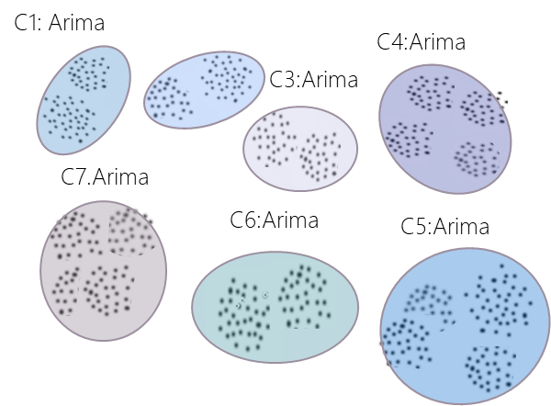
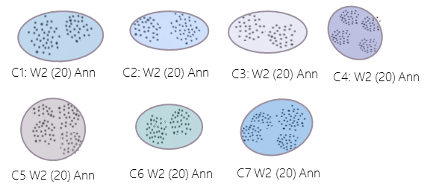
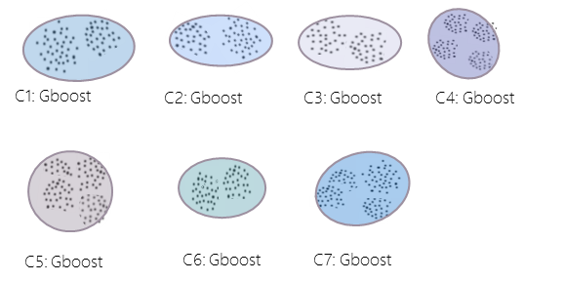

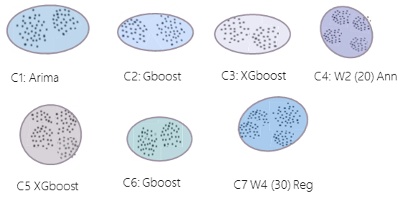
Slide 2
PREDICTIVE ANALYTICS (Modeling)
01
276.6
ARIMA Model
Pure time series model
02
Windowing Approach
Treating time series forecast a regression problem
250
03
Regression Model
Predict daily unit sales for each day by using regression
253
04
Combined Model
Train different models for each cluster
245
25
Notes:
In the time series, it's assumed that preceding values will have an affect on the current value. One way to account for this is to
Apply models that are capable of capturing different temporal structures and seasonality such Autoregressive Integrated Moving Average Model(ARIMA).
Treat time series forecast as a regression problem while taking preceding sales into account such as windowing.
Predict daily unit sales for each day by using regression and machine learning methodologies.

Slide 27
Slide 2
PREDICTIVE ANALYTICS (Lesson Learnt)
Important variables that have an impact on sales:
Weather
Color of the product
Brand of the product
Product sold date (5th day of the month)
Category of the product
Product is new or not
Size of the product
Variables that doesn‘t have a significant impact on sales:
Price daily change (a.k.a. discount)
Weekday of the month (Monday, Tuesday, etc.)
For time series problems, time series clustering that takes sales trend into account yields the best resullts
Clustering + Individual models for each clusters is the best technique
26
Notes:
Gradient Boosting Regression (GBR) and XGBoost Regression (XGBR)

Slide 28

Slide 11
THANK YOU

